Slide 1
Md. Abdul Malek Assistant Professor, Dept. of Electrical & Electronic Engineering (EEE) Rajshahi University of Engineering & Technology (RUET)

Slide 2
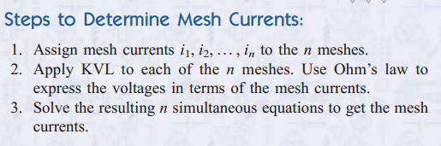
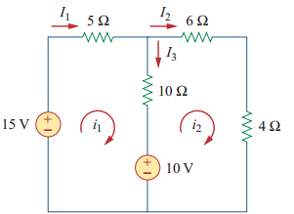
Mesh Analysis
A mesh is a loop which does not contain any other loops within it.
Mesh analysis provides another general procedure for analyzing circuits.
Mesh currents is used as the circuit variables.
Element current
Element current
Mesh current
Mesh current

Slide 3
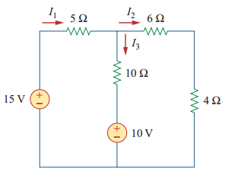
Mesh Analysis
Problem: Find the branch currents I₁, I₂ and I₃ using mesh analysis.

Slide 4
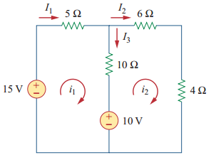
Mesh Analysis
Solution: Assign the mesh current
Apply KVL for mesh 1
+
_
+
_

Slide 5
Mesh Analysis
Apply KVL for mesh 2
+
_
+
_
+
_
_
+
+
_
After solving equation (i) and (ii), we get,

Slide 6
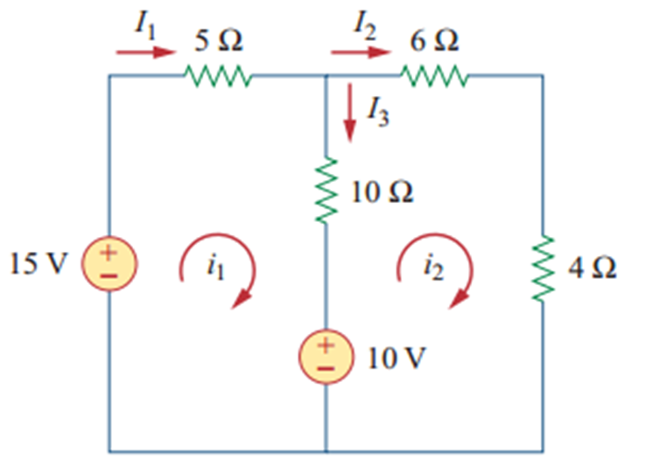
Mesh Analysis
Branch current is

Slide 7
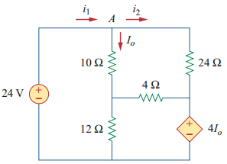
Mesh Analysis
Problem: Use mesh analysis to find the current I_{o}

Slide 8
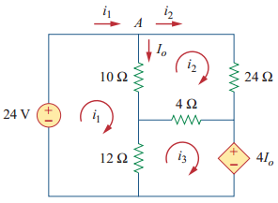
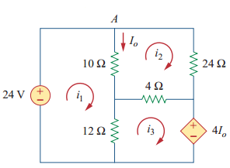
Mesh Analysis
Solution: Assign the mesh current
Apply KVL for mesh 1
+
_
+
_

Slide 9
Mesh Analysis
Apply KVL for mesh 2
+
_
+
_
+
_
_
+
+
_
+
_
Apply KVL for mesh 3
_
+
But,

Slide 10
Mesh Analysis
After solving equation (i), (ii) and (iii), we get,
Thus,

Slide 11
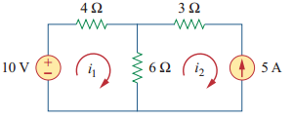
Mesh Analysis with Current Sources
When a current source exists only in one mesh, mesh current can be determined directly. Consider the above circuit, we can set i₂= -5 A and write a mesh equation for the other mesh in the usual way.

Slide 12
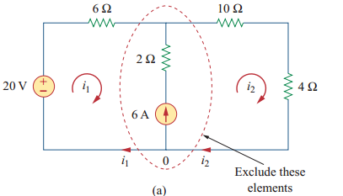
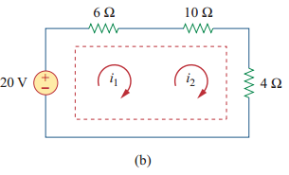
Mesh Analysis with Current Sources
When a current source exists between two meshes, we create a supermesh by excluding the current source and any elements connected in series with it.

Slide 13
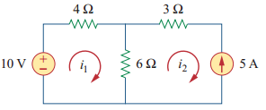
Mesh Analysis with Current Sources
Problem: Use mesh analysis to find the current i₁ and i₂

Slide 14
Mesh Analysis with Current Sources
Solution: i₂ current can be directly found from mesh 2 that is
_
+
+
Apply KVL for mesh 1
_

Slide 15
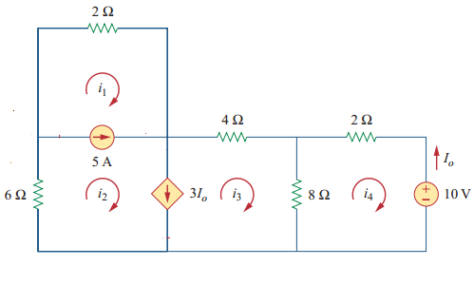
Mesh Analysis with Current Sources
Problem: Find i₁ to i₄ using mesh analysis.

Slide 16
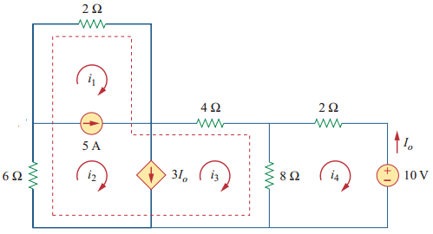
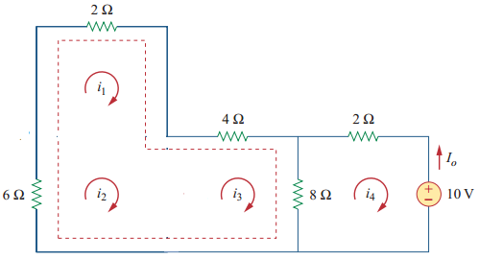
Mesh Analysis with Current Sources
Solution: Meshes 1 and 2 form a supermesh since they have an independent current source in common. Also, meshes 2 and 3 form another supermesh because they have a dependent current source in common. The two supermeshes intersect and form a larger supermesh as shown.

Slide 17
Mesh Analysis with Current Sources
_
+
_
+
_
+
+
_
Applying KVL to the larger supermesh

Slide 18
Mesh Analysis with Current Sources
_
+
_
+
_
_
+
_
+
+
_
+
Applying KVL to the mesh 4

Slide 19
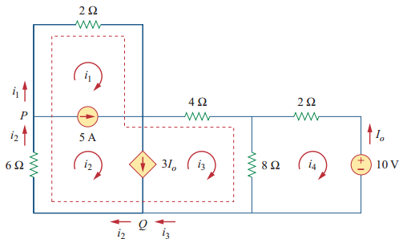
Mesh Analysis with Current Sources
But,

Slide 20
Mesh Analysis with Current Sources
After solving equation (i), (ii), (iii) and (iv), we get,

Slide 21
Home Work
Practice Problem: 2.9, 2.10, 2.14, 2.15, 3.1, 3.2, 3.3, 3.4, 3.5, 3.6, 3.7

Slide 22
Thank You

